Slide 1
AIR,WATER AND WEATHER

Slide 2
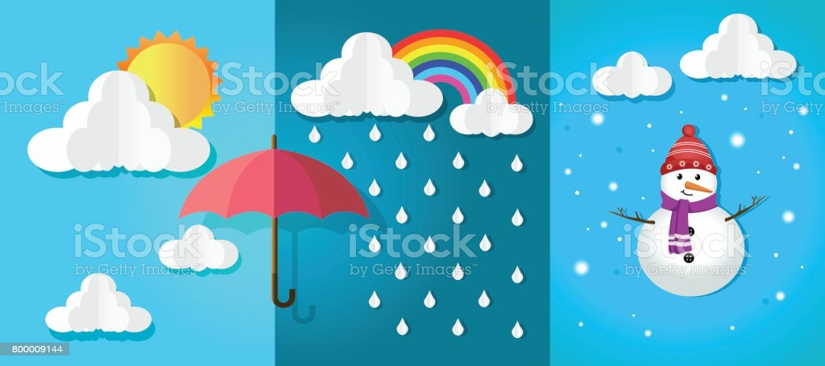
Different types of seasons:-
Summer
Rainy
Winter

Slide 3
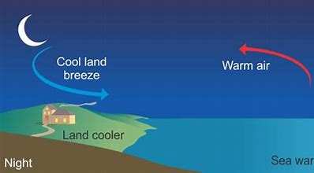
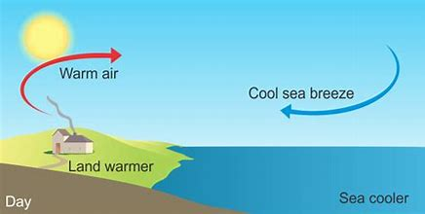
Types of Breeze
Land Breeze
Sea Breeze
Happens during the night.
Blows from land to sea.
Happens during the day.
Blows from sea to land.

Slide 4
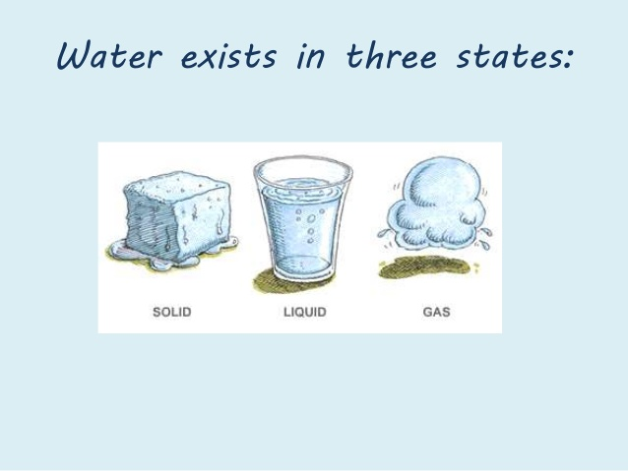
Different states of water:-
Solid:- Ice
Liquid:- Water
Gases:- Water vapour

Slide 5
Evaporation/Condensation
Evaporation
Condensation
The process by which water changes into water vapour is called evaporation.
The change of water vapour to water on cooling is called condensation.

Slide 6
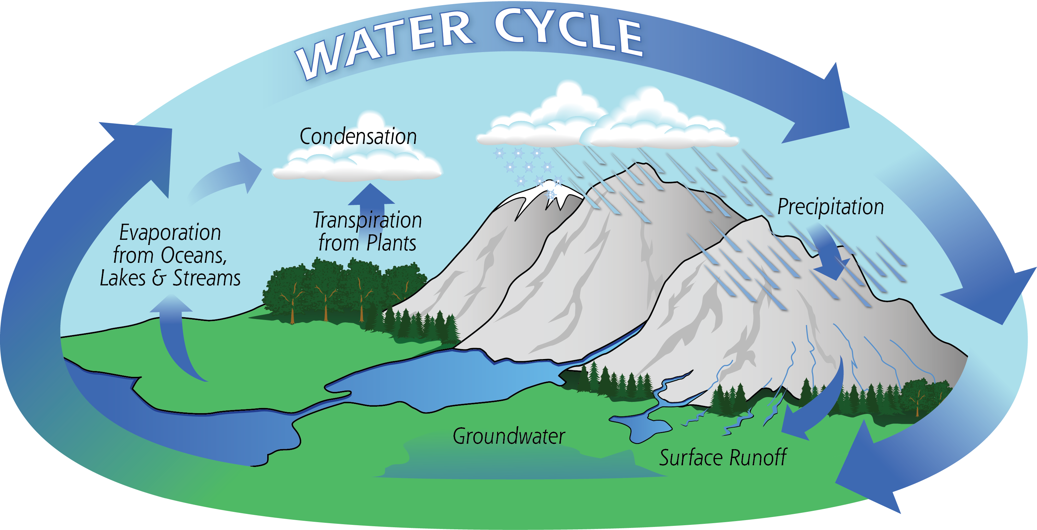
Water Cycle
The cycle of evaporation, condensation and precipitation in nature is called water cycle.

Slide 7
Thank you
Asha Singh

